Slide 1
Database Management System
First Lecture

Slide 2
Learning Outcomes…
Will Understand the role of a database management system in an organization.
Will be able to model an application’s data requirements using conceptual modeling tools like ER diagrams and design database schemas based on the conceptual model.
Will have a broad understanding of database concepts and database management system software.
Will have a high-level understanding of major DBMS components and their function.

Slide 3
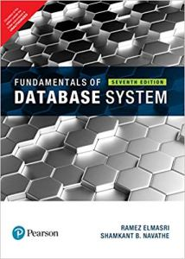

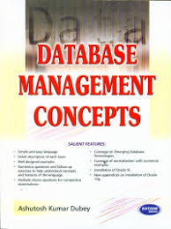
Text Book

Slide 4
Today’s Agenda
Introduction of DBMS
Data vs. Information
DBMS Concepts
Where is a DBMS being used?
What is DBMS?
Need of DBMS
Applications
Vendors

Slide 5
Why to Learn
Traditionally, data was organized in file formats. DBMS was a new concept then, and all the research was done to make it overcome the deficiencies in traditional style of data management. A modern DBMS has the following characteristics −
Real-world entity
Relation-based tables
Isolation of data and application
Less redundancy
Consistency
Query Language

Slide 6
Why Study Databases??
Shift from computation to information
at the “low end”: scramble to webspace (a mess!)
at the “high end”: scientific applications
Datasets increasing in diversity and volume. Digital libraries, interactive video, Human Genome project
... need for DBMS exploding
DBMS encompasses most of CS
OS, languages, theory, AI, multimedia, logic

Slide 7
Introduction of DBMS
Have you ever analyzed how the various university prepare results and manage various records related to the student and faculty?

Slide 8
What is DBMS
DBMS stands for:
Means:
Database Management System
Data
Base
Management
System

Slide 9
Introduction of DBMS
The software used for the management, maintenance and retrieval of the data stored in the database is called database management system (DBMS).
It is a collection of interrelated data and a set of program to access those data.

Slide 10
Introduction of DBMS
Database management system free the programmer from the need to worry about the organization and location of the data.
The primary goal of DBMS is to provide an environment which is both convenient and efficient to use in retrieving and storing information.
Example: University Results, IRCTC

Slide 11
Data Vs. Information
Data is the complete list of facts and details like text, observations, figures, symbols and description of things. It is the raw list of facts that are processed to gain information.
Data themselves are fairly useless, but when these data are interpreted and processed to determine its true meaning, they becomes useful and can be named as Information.
Information is data that has been processed in such a way as to be meaningful to the person who receives it. It is any thing that is communicated.

Slide 12
Data Vs. Information
Data can be anything like name of a person or a place or a number etc. Data is the name given to basic facts and entities such as names and numbers. The main examples of data are weights, prices, costs, numbers of items sold, employee names, product names, addresses, tax codes, registration marks etc.
Data can be of two types:
Qualitative data: It is the non-numerical data. For eg., texture of the skin, colour of eyes, etc.
Quantitative data: Quantitative data is given in numbers. Data in the form of questions such as “how much”, “how many”, gives the quantitative data.

Slide 13
Data Vs. Information
Information is data that has been converted into a more useful or intelligible form. It is the set of data that has been organized for direct utilization of mankind, as information helps human beings in their decision making process. Examples are: Time Table, Merit List, Report card, Headed tables, printed documents, pay slips, receipts, reports etc. The information is obtained by assembling items of data into a meaningful form. For example, marks obtained by students and their roll numbers form data, the report card/sheet is the information.

Slide 14
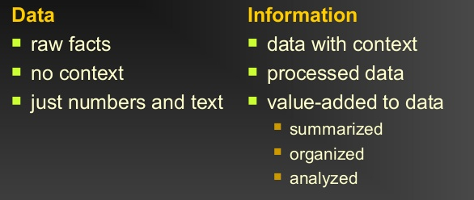
Data Vs. Information

Slide 15
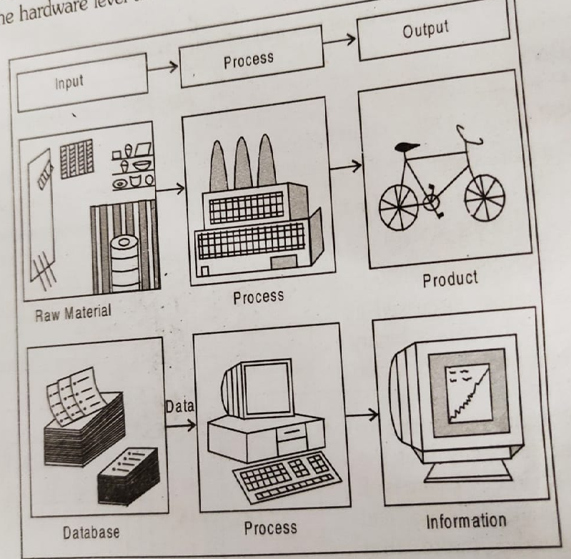
Example

Slide 16
DBMS Concepts
Database
Access data from database
Database system
Function of DBMS

Slide 17
Database
A database is a logically coherent collection of data with some inherent meaning representing some aspects of real world. It is designed built and populated with data for a specific purpose.
It consist of four elements:
Data Relationship Constraints Schema

Slide 18
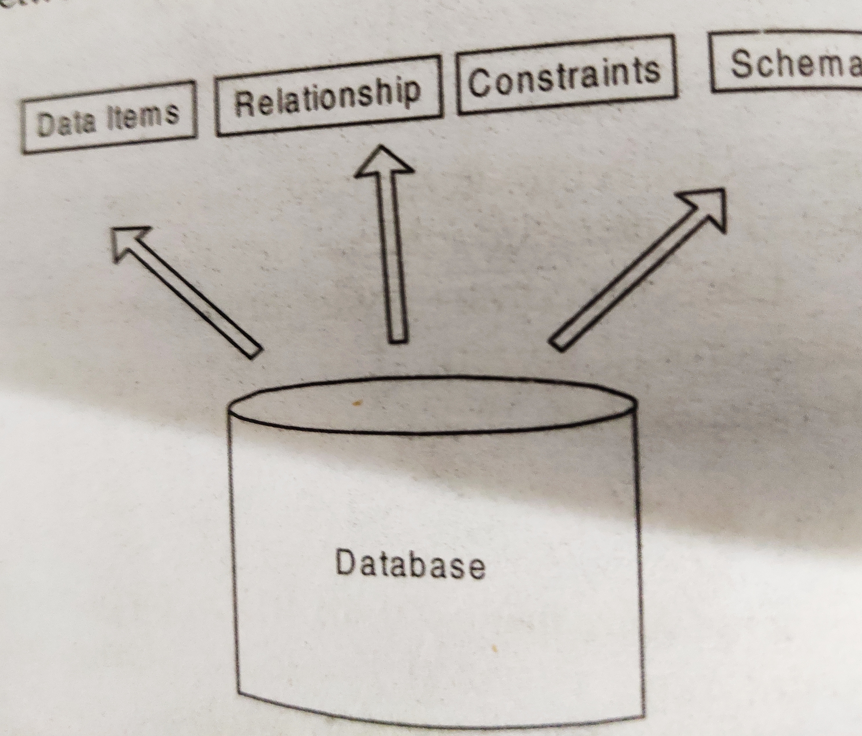
Database

Slide 19
Database
Data Items: Data are binary computer representation of stored logical entities. They are distinct pieces of information usually formatted in a special way. Data can exists in variety of forms like text, number or both.
Relationship: Relationship represents a correspondence between the various data elements.

Slide 20
Database
Constraints: Constraints enforce limits to the data or type of data that can be inserted/updated/deleted from a table. The whole purpose of constraints is to maintain the data integrity during an update/delete/insert into a table. In this tutorial we will learn several types of constraints that can be created in RDBMS.
Types of constraints
NOT NULL
UNIQUE
DEFAULT
CHECK
Key Constraints – PRIMARY KEY, FOREIGN KEY
Domain constraints
Mapping constraints

Slide 21
Database
Schema: The overall design of the database is called the database schema. It not only describes the organization of data but also represents the relationship between various tables in a database.

Slide 22
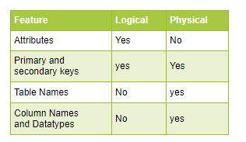
Types of Schema
Logical Database Schema: This represents how the data is organized in terms of tables, and how the different attributes in the different tables link them. Different database management systems use different syntax to define the logical architecture and constraints of a database which is called logical database schema.
Physical Database Schema: This represents how data is stored physically on disk storage.
Database schema is Just a representation and it does not contain any data.

Slide 23
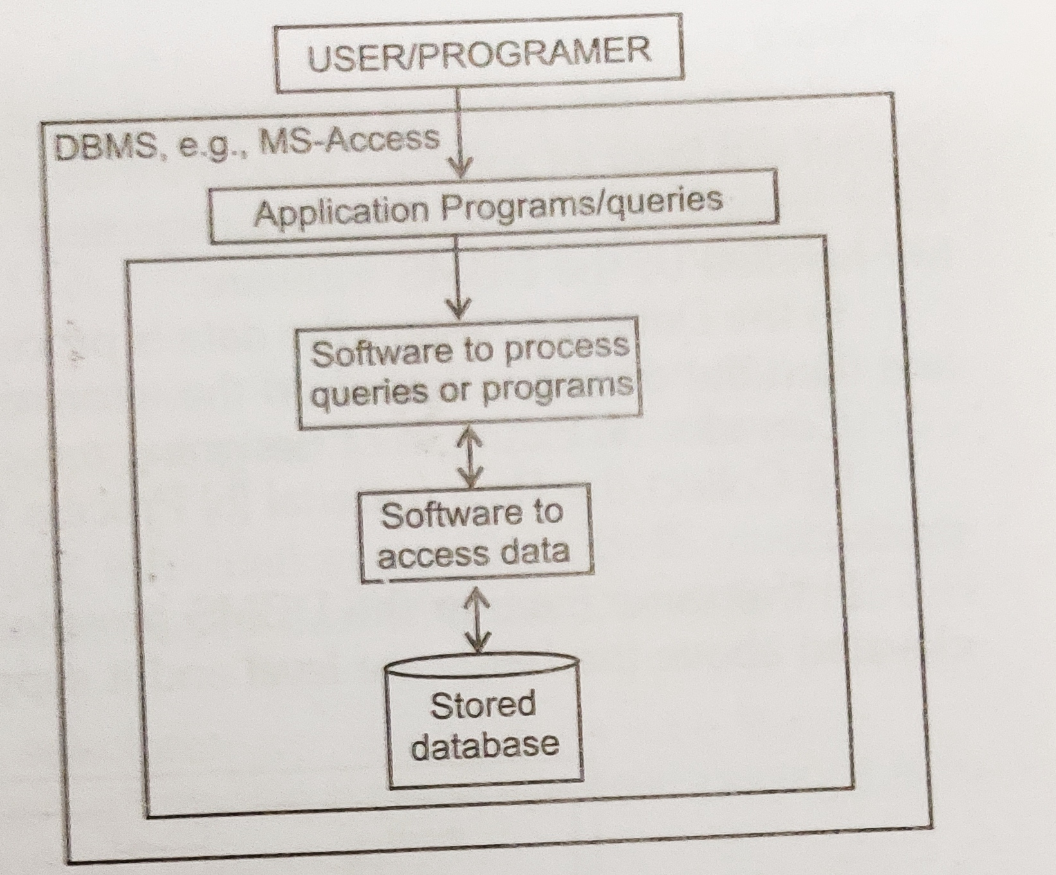
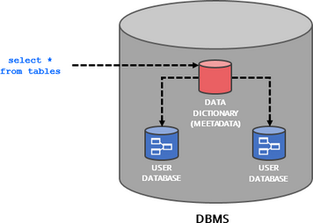
Accessing data from Database

Slide 24
Metadata
Metadata is simply data about data. It means it is a description and context of the data. It helps to organize, find and understand data. Here are a few real world examples of metadata:
Title and description,
Tags and categories,
Who created and when,
Who last modified and when,
Who can access or update.

Slide 25
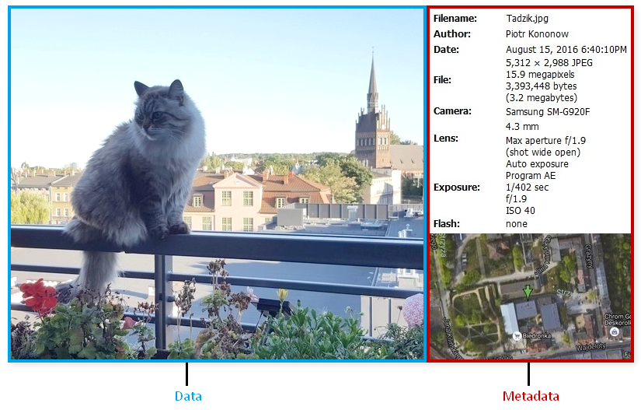
Metadata
Every time you take a photo with today's cameras a bunch of metadata is gathered and saved with it:
date and time,
filename,
camera settings,
geolocation.
Source: https://dataedo.com/kb/data-glossary/what-is-metadata

Slide 26
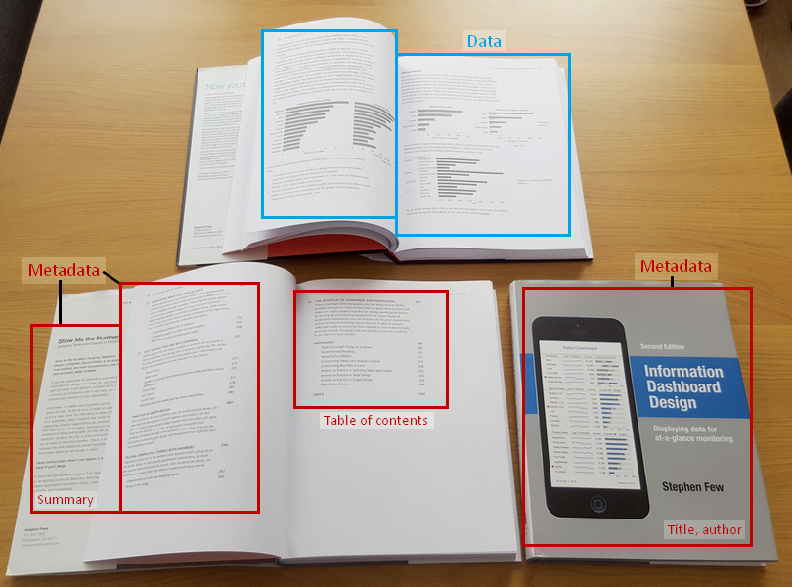
Metadata
Each book has a number of standard metadata on the covers and inside. This includes:
a title,
author name,
publisher and copyright details,
description on a back,
table of contents,
index,
page numbers.
Source: https://dataedo.com/kb/data-glossary/what-is-metadata

Slide 27
Metadata
Most popular databases provide access to their metadata with a set of tables or views often called system catalog or data dictionary. Many of them implement or standard information schema. We can access those views using SQL.

Slide 28
Database System
It is a collection of database and DBMS software.
It consist of four major components:
Data
Hardware
Software
Database Users

Slide 29
Database System
It is a collection of database and DBMS software.
It consist of four major components:
Data
Hardware
Software
Database Users

Slide 30
Database System
Hardware
The secondary storage volumes-typically magnetic disks that are used to hold the stored data together with the associated I/O devices like disk drives, device controller, I/O Channel etc.
The hardware processor and associated main memory that are used to support the execution of the database system software.

Slide 31
Software and Database Users
All request for access to the database are handled by the DBMS software.
The primary goal of the system is to retrieve data and store new data in the database. People who work with a database can be categorized as the database users and administrator.
We will discuss it in detail in the next class.

Slide 32
Function of DBMS
Accept data definition in the source form and convert.
Creation of records.
Query
DDL Compiler
DDL Compiler
Transaction Processing
Data dictionary function
Metadata task

Slide 33
Application of database
Universities
Hospital
Bank
Railway reservation
Airlines
Human resources
IT Industry
Telecommunication
Credit and transactions

Slide 34
Popular database system vendors
Oracle
IBM
MSSQL-Server
Sybase
Informix
MS Access
Fire Bird
Mark Logic
My SQL

Slide 35
Big name in databases
Company | Product
Oracle | 8i, 9i, 10 g, 11g, 12c, 18c, 19c, 21c
IBM | DB2, Universal Server
Microsoft | Access, SQL Server
Sybase | Adaptive server
Informix | Dynamic server

Slide 36
Introduction to Database Management System
As the name suggests, the database management system consists of two parts. They are:
1. Database and
2. Management System

Slide 37
What is a Database?
To find out what database is, we have to start from data, which is the basic building block of any DBMS.
Data: Facts, figures, statistics etc. having no particular meaning (e.g. 1, ABC, 19 etc).
Record: Collection of related data items, e.g. in the above example the three data items had no meaning. But if we organize them in the following way, then they collectively represent meaningful information.

Slide 38
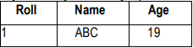
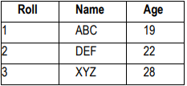
Cont…
Table or Relation: Collection of related records.
The columns of this relation are called Fields, Attributes or Domains. The rows are called Tuples or Records

Slide 39
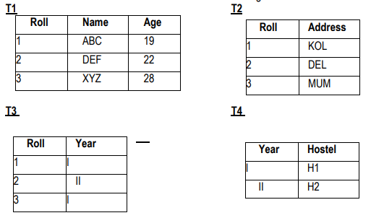
Cont…
Database: Collection of related relations. Consider the following collection of tables:
We now have a collection of 4 tables. They can be called a “related collection” because we can clearly find out that there are some common attributes existing in a selected pair of tables. Because of these common attributes we may combine the data of two or more tables together to find out the complete details of a student. Questions like “Which hostel does the youngest student live in?” can be answered now, although Age and Hostel attributes are in different tables.

Slide 40
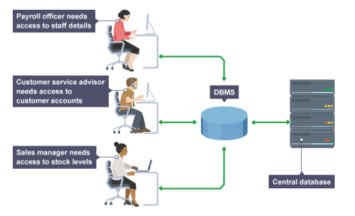
Cont…
A database in a DBMS could be viewed by lots of different people with different responsibilities.
For example, within a company there are different departments, as well as customers, who each need to see different kinds of data. Each employee in the company will have different levels of access to the database with their own customized front-end application.
: Empolyees are accessing Data through DBMS

Slide 41
Cont…
In a database, data is organized strictly in row and column format. The rows are called Tuple or Record. The data items within one row may belong to different data types. On the other hand, the columns are often called Domain or Attribute. All the data items within a single attribute are of the same data type.

Slide 42
What is Management System?
A database-management system (DBMS) is a collection of interrelated data and a set of programs to access those data. This is a collection of related data with an implicit meaning and hence is a database. The collection of data, usually referred to as the database, contains information relevant to an enterprise. The primary goal of a DBMS is to provide a way to store and retrieve database information that is both convenient and efficient. By data, we mean known facts that can be recorded and that have implicit meaning

Slide 43
Database Management System (DBMS)???
A Database management system is a computerized record-keeping system. It is a repository or a container for collection of computerized data files. The overall purpose of DBMS is to allow he users to define, store, retrieve and update the information contained in the database on demand. Information can be anything that is of significance to an individual or organization.

Slide 44
In ALL DBMS is…
Data- Any fact that can be recorded
e.g. texts, numbers, alphanumeric, audio, video, image.
Database- Collection of interrelated data
Types of Database-
Traditional database
Multimedia database
Geographic Information System (GIS) database
Real time database
Data Warehouse (huge volume of historical data)
DBMS: Collection of interrelated data and a set of programs to access those data. It helps us to store and retrieve database information in a convenient and efficient manner

Slide 45
Need of DBMS???
Provide a highly efficient method for handling large amount of different types of data with ease.
Database allows data to be stored systematically.
Data can be easily retrieved, filtered, sorted and updated efficiently and accurately.

Slide 46


